Slide 1
BRITHIST AIRWAYS
Sentiment Analysis On Reviews With K-means
Present : Mulia Parna Putri Sijabat

Slide 2

Clustering of sentiment analysis base on reviews
Clustering sentiment analysis results based on reviews can help you group similar sentiments together and gain insights from your data.
Data was taken from the website: https://www.airlinequality.com/airline-reviews/british-airways to analyze reviews from users of the service.
The grouping is divided into : Negative and Positive reviews

Slide 3
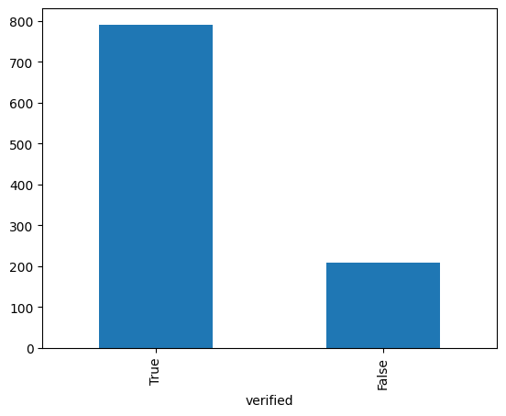
Clustering of sentiment analysis base on reviews
Two types of users who carry out reviews : Trip Verified and Not Verified

Slide 4
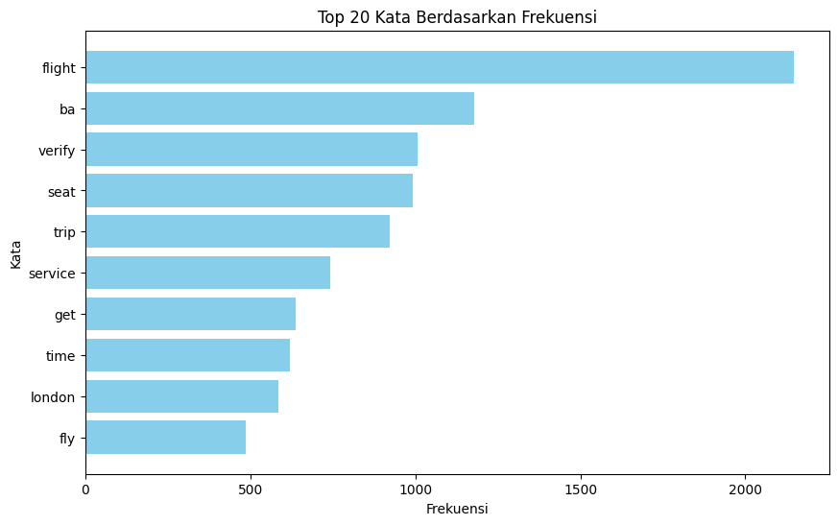
Clustering of sentiment analysis base on reviews
After exploratory dataset, we need to clean data from unknown word or etc, tokenization, removing stop words, lemmatization and then make a corpus.
So, we can see the frequency with which each word appears.

Slide 5
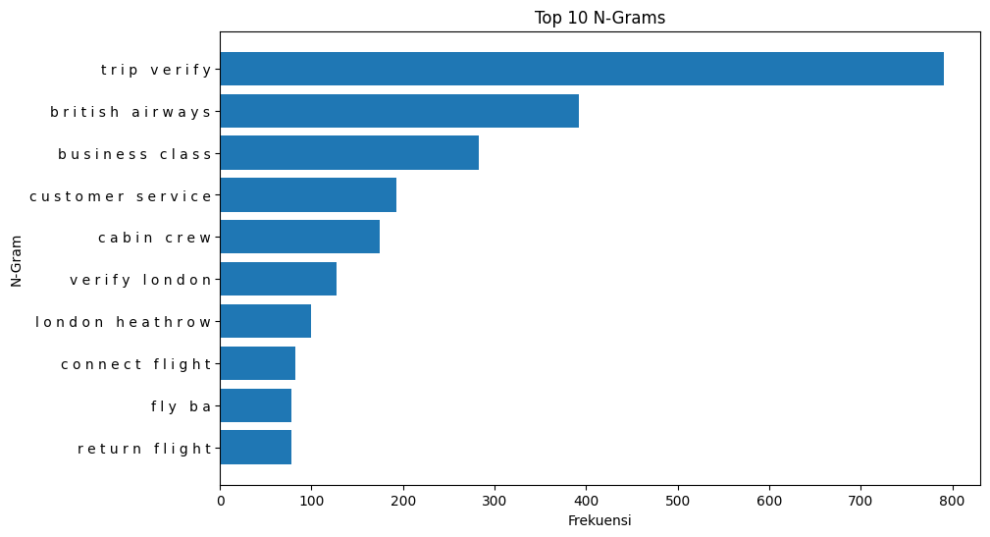
Clustering of sentiment analysis base on reviews
Also we can see the frequency with each most sentences.

Slide 6
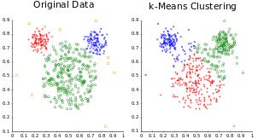
Clustering of sentiment analysis base on reviews
I use the K-means algorithm to determine whether the reviews lead to negative reviews or positive reviews

Slide 7
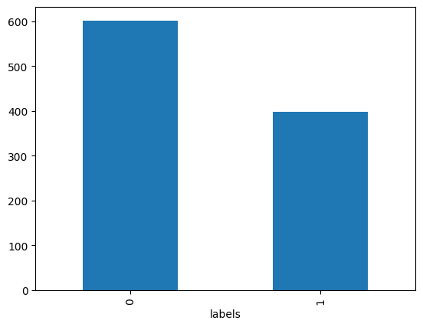
Clustering of sentiment analysis base on reviews
From the diagram it can be seen that there are more negative reviews than positive reviews

Slide 8
THANK YOU

